Slide 1
DBMS
CLASS TASK

Slide 2
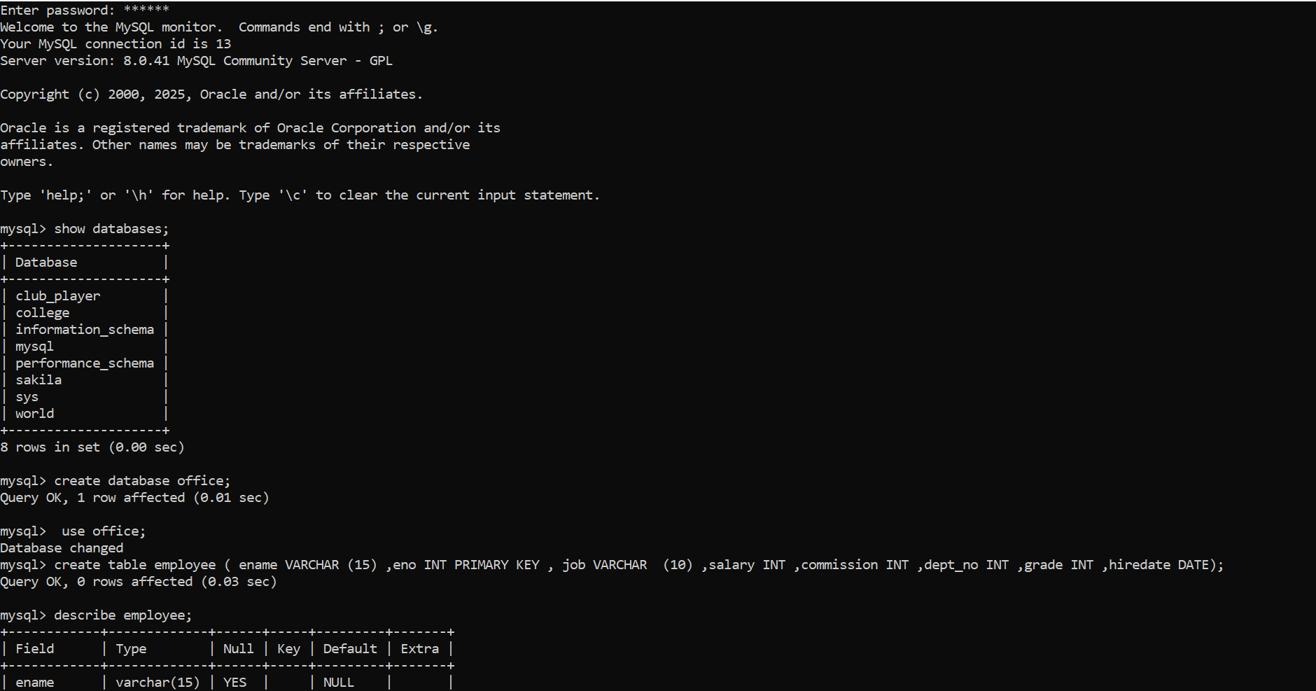

Slide 3
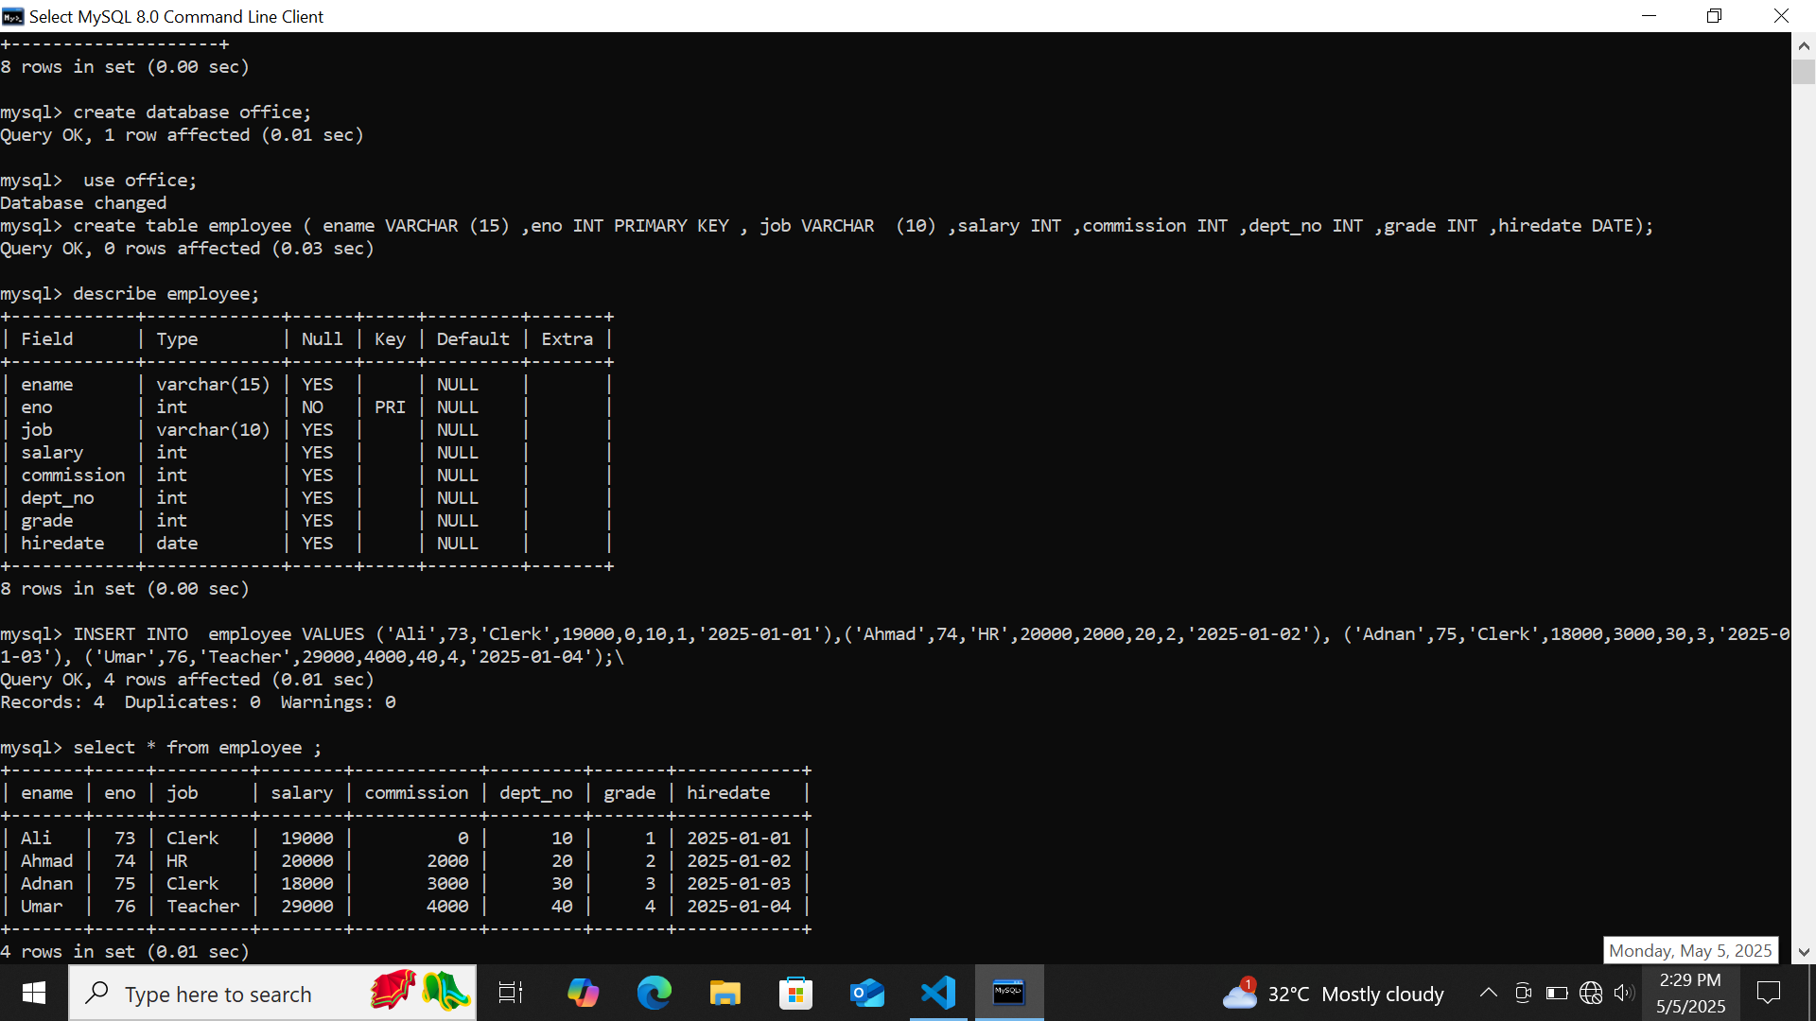

Slide 4
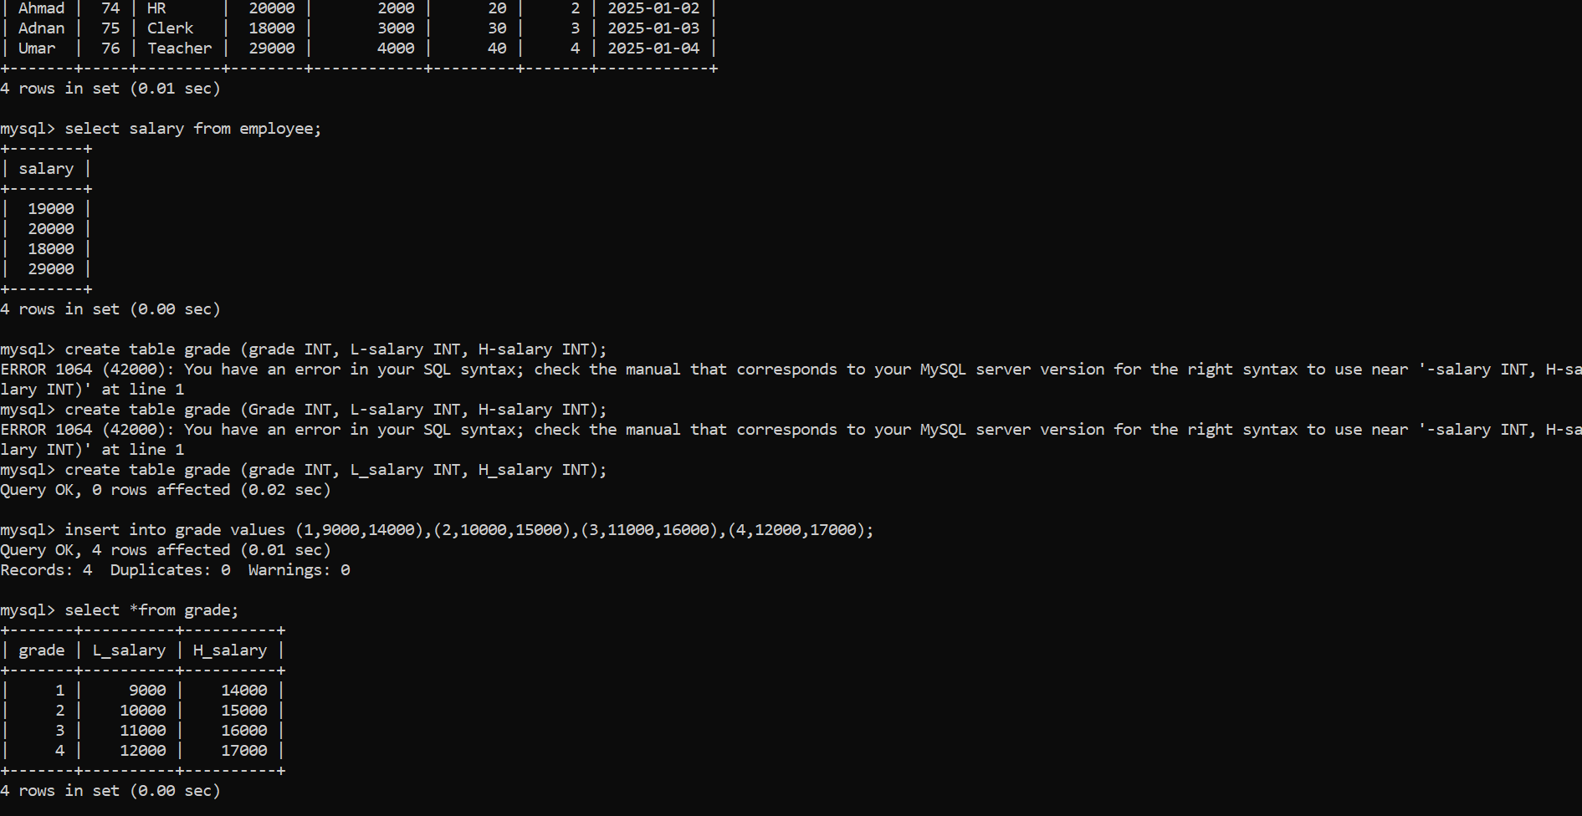

Slide 5


Slide 6
